Slide 1
Detroit South Community Meeting
July 30, 2024

Slide 2
Thank you, Coach K, for your help with organizing.

Slide 3
Agenda & Discussion
Detroit South Update
- Compliance
- Consent Order
- Resumption of Operations
Community Update
- Actions Update
- CBA (Community Benefits Agreement)
Next Steps
- SEP (Supplemental Environmental Projects)
- Website

Slide 4
Detroit South Update

Slide 5
Detroit South Updates
Regulator Inspections
5 EGLE inspections since January
Date | Event | Result
1/1/24 | Hazardous Waste and Liquid Industrial Byproduct Inspection | Compliance communication received electronic manifest uploads for select manifests. Uploads have been submitted. No further action required.
3/21/24 | Solid Waste Inspection | In compliance
5/1/24 | Financial Assurance Inspection | In compliance
6/3/24 | Hazardous Waste and Liquid Industrial Byproduct Inspection | Compliance communication received regarding transfer facility operation. Amendment to the license renewal application is due on August 16.
7/11/24 | Solid Waste Inspection | In compliance
Compliance
Regulator Violations
2 GLWA violations since January
Date | Event | Result
2/21/24 | Self-reported Possible pH Exceedance | Continuous pH monitoring identified three instances in which pH was elevated for a short-term interval in January and February. Caused by faulty pH probe that provided a false high reading and has been replaced. No further action required.

Slide 6
Detroit South Updates
Compliance
Odor Reports
0 odor reports received by EGLE and shared with DS since January
Date | Description | EGLE Follow-Up | Notes
1/9/24 | Burning oil | No further action | Normal operations authorized by permit.

Slide 7
Detroit South Updates
Consent Order Background:
EGLE inspection in April 2023 found liquids in interstitial space
EGLE issued violations in May 2023
Some infiltration of tank steel liners
Groundwater infiltration of secondary containment system
Temporarily paused site operations to conduct additional investigations and repairs
Consent Order
Facility underwent major improvements and investigations since EGLE Enforcement
Investigation found no offsite impacts to the groundwater table
Installed 19 groundwater wells
Developing a site-wide Hydrogeological Monitoring Program (HMP)
Removed 6 tanks and conducted concrete repairs
Removed 80k gallons of perched water with perimeter drain system

Slide 8
Detroit South Updates
Consent Order Finalization:
Republic Services and EGLE reached an agreement on July 15, 2024
Terms of Consent Order:
$985,955 penalty to be paid by Republic
$927,423 of total will be used to finance an escrow account, pending development of possible supplemental environmental projects (SEP)
Implement improved waste acceptance and screening procedures
Complete a feasibility study evaluating additional air emission controls for the purpose of controlling odors
Ensure waste treatment tanks meet all applicable standards
Conduct regular groundwater monitoring
Consent Order

Slide 9
Detroit South Updates
Resumption of Operations
Beginning July 22, site operations have resumed – phased approach over the next couple of months
Temporary operations at DN returning to DS
Should see minimal truck impact

Slide 10
Detroit South Updates
Over $10M in operational improvements made thus far, including:
Tank System Improvements:
Current plans incorporate multiple layers of additional, redundant protections and state-of-the-art electronic leak detection
Engineering plans for additional upgrades to the tank system will be submitted by mid-August
Groundwater Monitoring:
Data continues to show no signs of groundwater impacts from operations
Expanded Hydrogeological Evaluation Report has been submitted to EGLE
Long-term GW Monitoring Program under development
Operational Updates

Slide 11
Community Update

Slide 12
Actions Update
Community Update
Community Benefits Agreement
Ongoing meetings to advance Community Benefits Agreement
Targeting finalization of an agreement by fall
Sewer system evaluation
Worked with the City of Detroit on sewer investigation and repair on behalf of community
Met with GLWA and DPW on sewer system
Website
Finalizing community website to increase transparency and better communicate with community
DetroitES.com

Slide 13
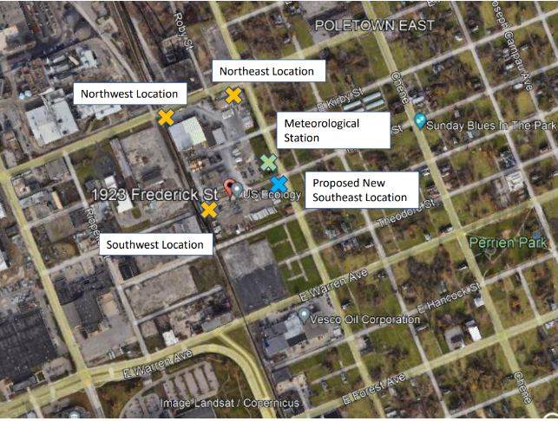
Actions Update
Community Update
Joe Louis Greenway Project support
City of Detroit received $20.7 million in federal funding for the project
Construction is expected to begin in October 2025
Air monitoring and discharge monitoring transparency
Additional air station will be added to southeast corner
Direct odor reporting capability
Host future community meeting onsite

Slide 14
Community Update
Community Benefits Agreement
Status & Discussion
Notes:
Rev. Buttry

Slide 15
Next Steps

Slide 16
Next Steps
A Supplemental Environmental Project (SEP) is an environmentally beneficial project as part of a settlement of an enforcement action, but which the company is not otherwise legally required to perform
SEPs are a key component of EGLE’s strategy to enhance environmental and public health protection and must meet one or more of the following categories:
Pollution prevention & reduction
Environmental restoration & protection
Public health
Environmental assessments & awareness
Climate change mitigation & preparedness
Emergency planning & preparedness
Supplemental Environmental Projects

Slide 17
Next Steps
$927,423 will be used to finance an escrow account, in anticipation of supplemental environmental projects (SEP) applications
EGLE allows Republic the opportunity to develop how SEP is going to work
We want to approach the process collaboratively
Consent order gives us a year to complete the program
Supplemental Environmental Projects

Slide 18
Next Steps
DetroitES.com will host an application form for community members to submit proposed SEP projects
Tentative SEP Application Timeline:
September 1: Application period opens
December 1: Application period closes
December – January: EGLE review period
If needed:
February 1: Second application period for modifications to previously submitted ideas opens
March 1: Second application period closes
March – April: Additional EGLE Review
SEP Process Thought Starter

Slide 19
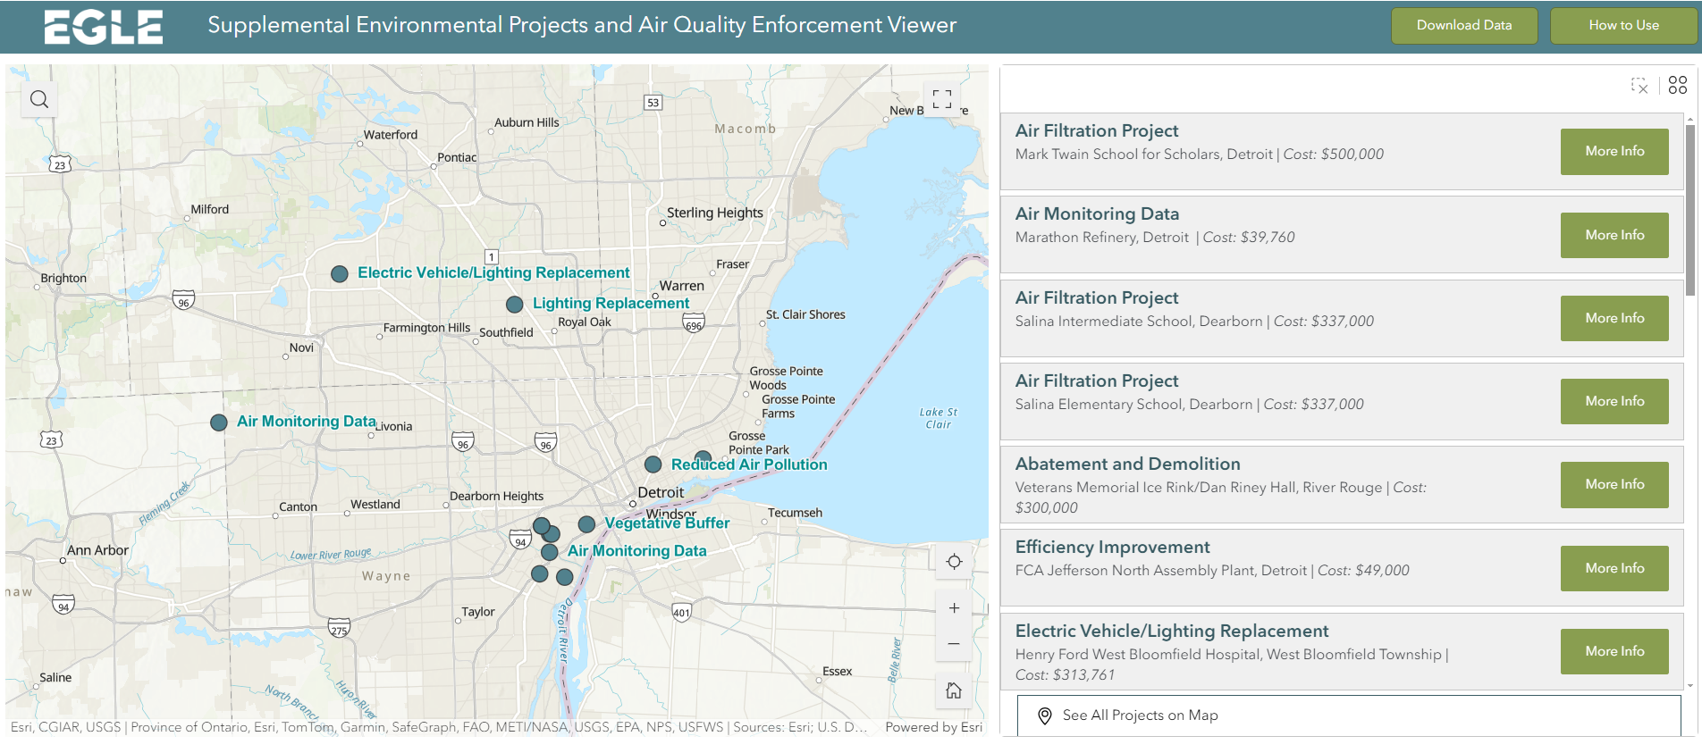
Next Steps
Learn more about SEPs and local projects that have been put in place at: www.michigan.gov/egle/about/organization/air-quality/air-quality-enforcement/supplemental-environmental-projects

Slide 20
Next Steps
Community Website
DetroitES.com
Notes:
https://republic-services.flywheelstaging.com/

Slide 21
Questions?

Slide 22
Appendix

Slide 23
What We Heard
Many do not want DS here, but if DS is going to operate, the community conducted ranked voting for the following / must haves:
26% mitigate odors
20% restricting chemicals of concern
13% transparency of materials and monitoring data
7% community meetings
7% truck washing stations, truck routes and dust reduction
7% road improvements
7% sewers and infrastructure issues
7% air monitoring (24-hour basis) and details on PM and VOCs need to be addressed
7% buffers
Actions Update

Slide 24
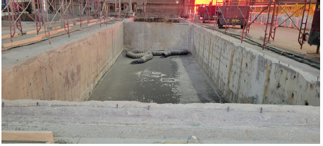
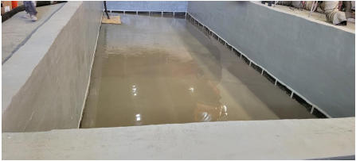

Slide 25
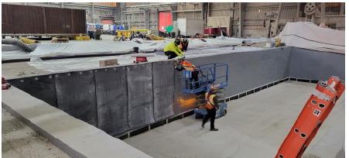
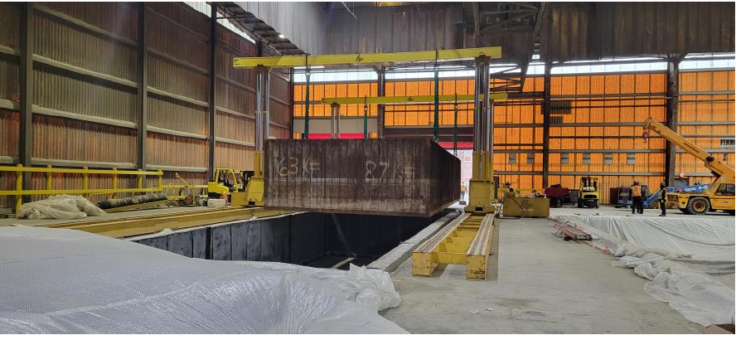

Slide 26
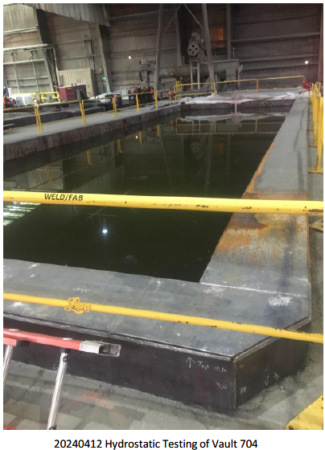
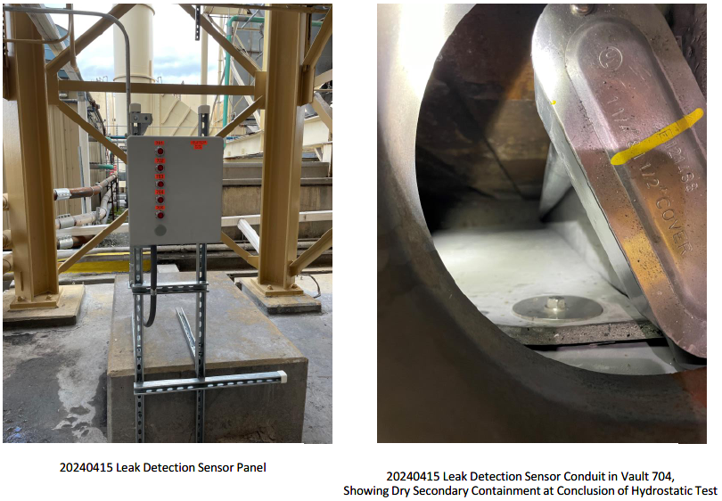

Slide 27
